Slide 1
Rail Cargo Hungaria Zrt.
Intermodal solutions in and across Hungary
Ukraine, Odessa, 01.06.2017

Slide 2
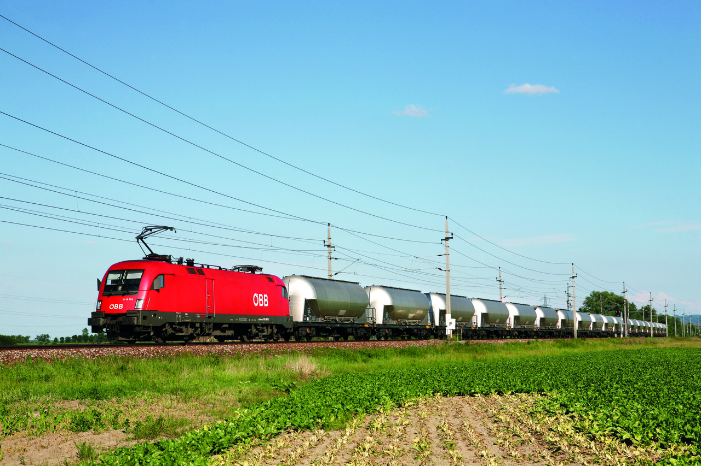
The ÖBB in numbers
~ 6.900 employees
459 Million passengers
96,3% punctuality
11% share of traffic
~ 8.200 employees
Presence in 18 countries
109,2 Million Tons of transported goods
~ 17.700 employees
1.095 train stations
668 GWh self-produced energy
~ 1,7 Billion EUR investment

Slide 3
International presence – subsidiaries
Austria
RCA
RCL-AT
RCL-MAC
RCL-ES RCO-AT
RCW-AT
ÖBB-TS
Croatia
RCL-HR
RCC-HR
Turkey
RCL-TR
Poland
RCL-PL RCO-CSKD
Czech Republic
RCL-CZ RCL s.r.o.
RCO-CSKD
RCT-PRG
RCC-CZ RCA
North Sea
Sweden
Riga
Russia
Denmark
Latvia
Copenhagen
Lithuania
Vilnius
Slovakia
RCL-CZ
RCO-CSKD RCC-SK
TS-SK
Hungary
RCH
RCC
RCL-HU
RCO-HU
RCT-BIL
TS-MAV
TS-HU
Minsk
Amsterdam
Berlin
Warsaw
Belarus
Netherlands
Poland
Belgium
Brussels
Germany
Kiev
Luxembourg
Prague
Ukraine
Russia
RCL-RU
Czech Republic
Slovakia
Vienna
Bratislava
Moldova
Switzerland
Austria
Budapest
Chisinau
Germany
RCL-DE
RCO-DE RCC-DE RCC-PCT RCA
Bern
Hungary
Romania
RCL-RO
RCC-RO
Maribor
Romania
Slovenia
Croatia
Bucharest
Zagreb
Bosnia and Herzegovina
Serbia
RCL … Rail Cargo Logistics
RCO … Rail Cargo Operator
RCT … Rail Cargo Terminal
RCC … Rail Cargo Carrier
RCW … Rail Cargo Wagon
RCA … Rail Cargo Austria
RCH … Rail Cargo Hungaria
ÖBB-TS ... ÖBB-Technische Services
Sarajevo
Belgrade
Bulgaria
Italy
Montenegro
Sofia
Bulgaria
RCL-BG
RCC-BG RCA
Italy
RCL-IT
RCT-DES
RCT-STI
RCC-IT
Corsica
Rome
Podgorica
Tirana
Skopje
Macedonia
Sardinia
Albania
Greece
Turkey
Slovenia
RCC-SI RCA
Bosnia-Herzegovina
RCL-BH
Greece
RCL Goldair RCT-SIN

Slide 4
Rail Cargo Group: Your partner in Europe
North Sea
Rail Cargo Group
18 countries between the North Sea, the Black Sea and the Mediterranean
5 rail businesses
Black Sea
Mediterranean

Slide 5
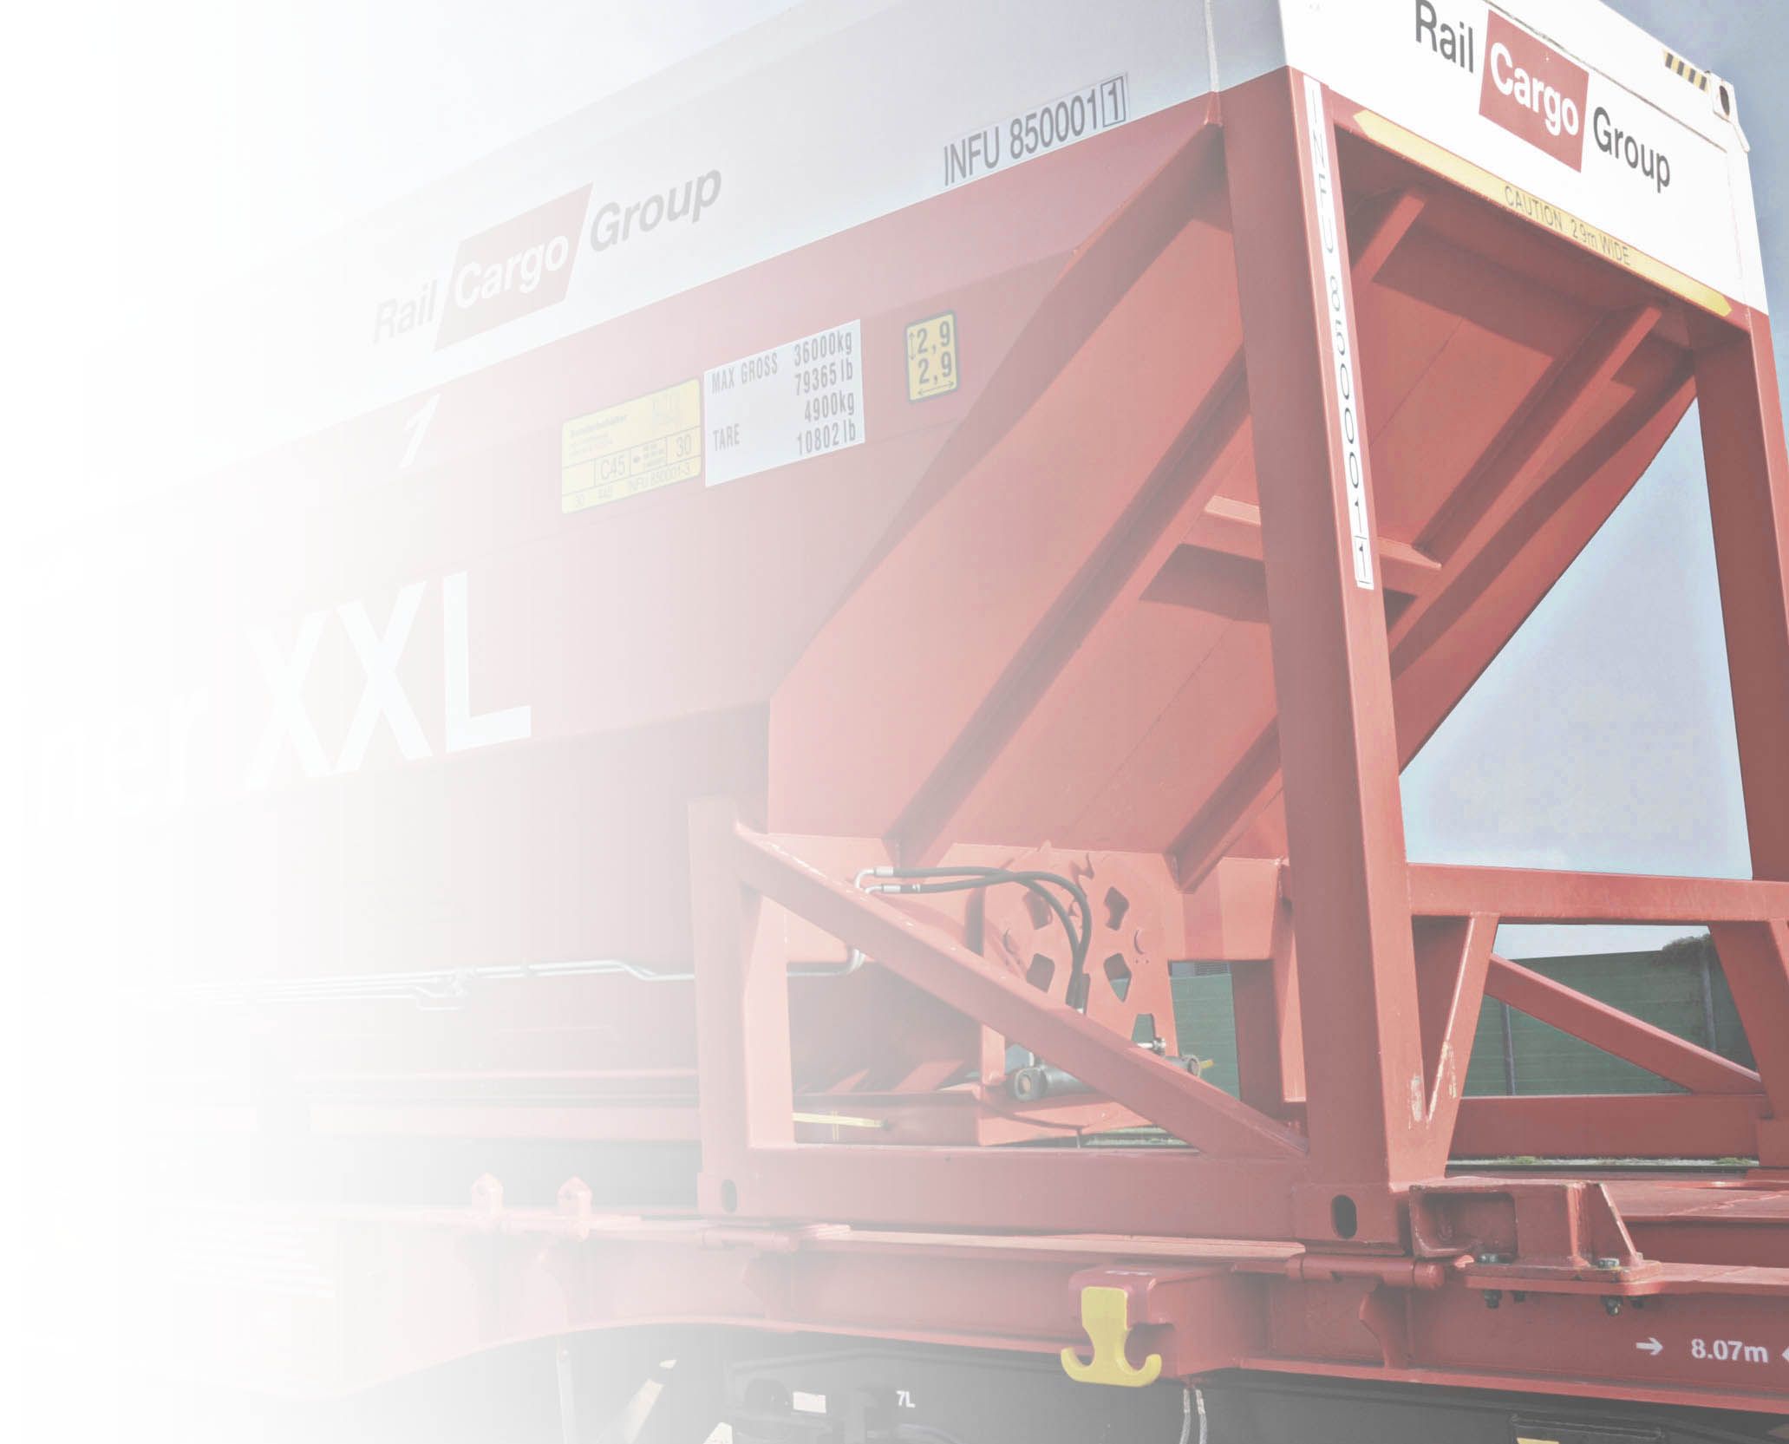
Rail Cargo Group at a glance
STATUS: 2015
Turnover € 2.1 billions, € 76.6 millions EBIT
Goods carried 109.2 million tonnes
Tonne kilometres 29.1 billion tonnes-km
Staff 8,260
Locomotives 485 service locomotives
171 shunting locomotives
Wagons 21,445
5 rail business units 15 Rail forwarding units 4 Operating companies 10 RU 1 Wagon lessor 4 Rolling stock maintenance companies

Slide 6
Rail Cargo Group business model
Rail forwarding with specialist sector competence
1
Focus on core competence: railway logistics
Transparency through simplicity and five businesses, each with its own model and markets (internal, external)
Bringing together skills, resources and responsibilities
Consistent brand architecture
Operator for high-frequency long-distance routes
2
Carrier for in-house traction provision
ÖBB-Produktion GmbH
3
4
Wagon rental
5
Rolling stock maintenance
ÖBB-Technische Services GmbH Technical Services Hungaria Kft.
Technical Services Slovakia, s.r.o.
TS-MÁV Gépészet Kft.

Slide 7
RCC objective: fast, safe and high-quality transports throughout Europe
International traction entity of Rail Cargo Group with locos and personnel provided internally
Focus: high-quality, international long-distance transports – last-mile services and single wagon traffic through the cooperation with national partner RUs
High quality of transports through seamless cross-border operations using modern locomotives and overall traffic monitoring
Bremerhaven
Hamburg
Bremen
Duisburg
Krefeld
Neuss
Děčín
Chalupki
Ludwigshafen
Regensburg
Zahony
Giengen
München
Passau
Salzburg
Curtici
RPA
Brennero
Bilk
Vintu de Jos
Sfantu Gheorge
Trento
Monfalcone
Ciumesti
Brazi
Verona
Trieste
Koper
ŠID
Ploiesti
Constanza
Cava Tigozzi
Rijeka
Volinja
Lugo
Ruse
Kapikule
Cerkezköy
Tekirdag
Halkalı
actual traffic flows
Planned traffic flows
third party RU (e.g.: DB, Lotos,PKP, TCDD)

Slide 8
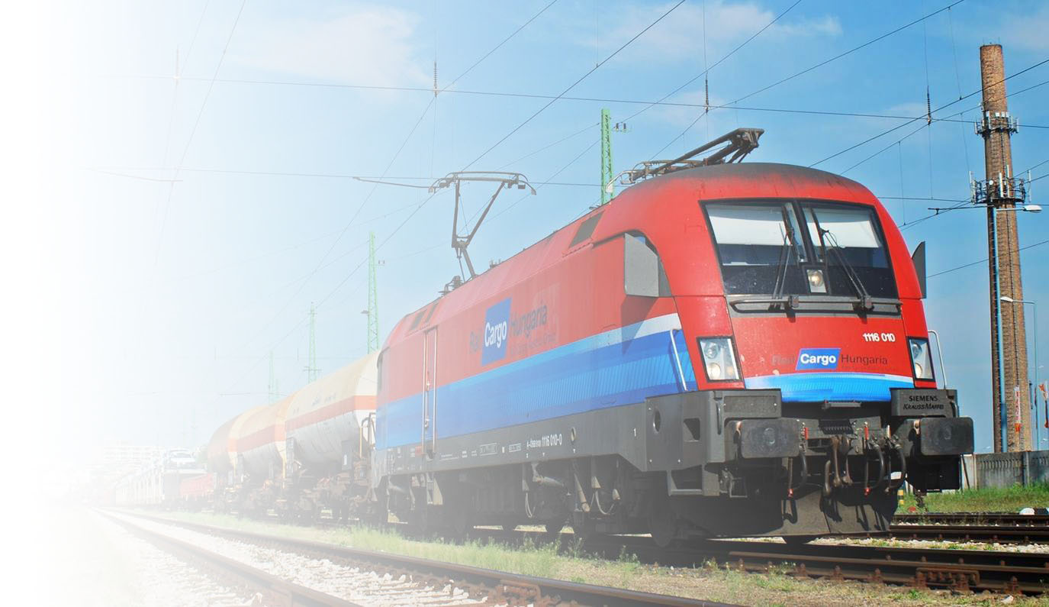
Rail Cargo Hungaria in numbers
About 1900 employees
About 9,000 wagons
25 Taurus locomotives
150 locomotive drivers
32 million tons transported
Almost 700 service points
65% market share in Hungary

Slide 9
Distribution of traffic volume of Rail Cargo Hungaria
The subsidies of the Hungarian State for single-wagon forwarding: HUF 0.

Slide 10
Traffic volume according to segments in 2016 (percentage)
Notes:
Frissíteni, KÉSZ

Slide 11
PGV Agreement
The regulations of the new PGV valid as of 01/07/2017 and joining the multilateral PGV Agreement make it possible for RCH to be able to enter into contract with any wide-gauge rail transporter/operator on a normative basis.
RCH’s request to join submitted in February 2017 was accepted by the OJD Head Committee in its letter dated 20th February, and is valid as of 01/07/2017.
Notes:
Az OSZZSD KGD határozatának megfelelően a PGV tagok egymás között közvetlenül kell, hogy leszámoljanak, ennek megfelelően kezdeményeztük az RZD-vel kétoldalú leszámolási megállapodás megkötetést.
Jelenleg a megállapodás szövegének egyeztetése folyik, amelyet szakértői egyeztetés fog követni. A megállapodás a PGV tagságunkkal egy időben 2017. július 01-től lép hatályba.

Slide 12
Záhony-Port Co.
Source: Záhony-Port Co.

Slide 13
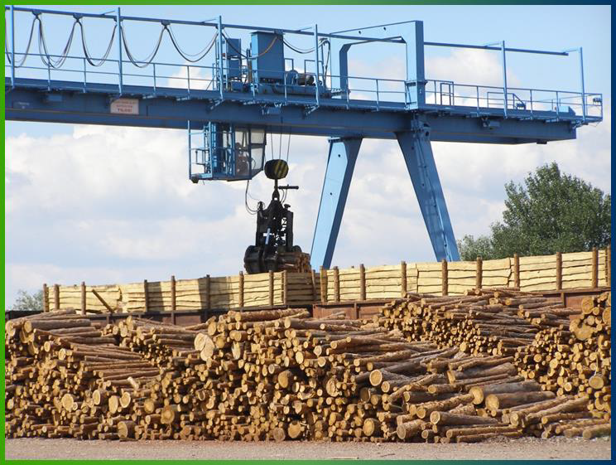
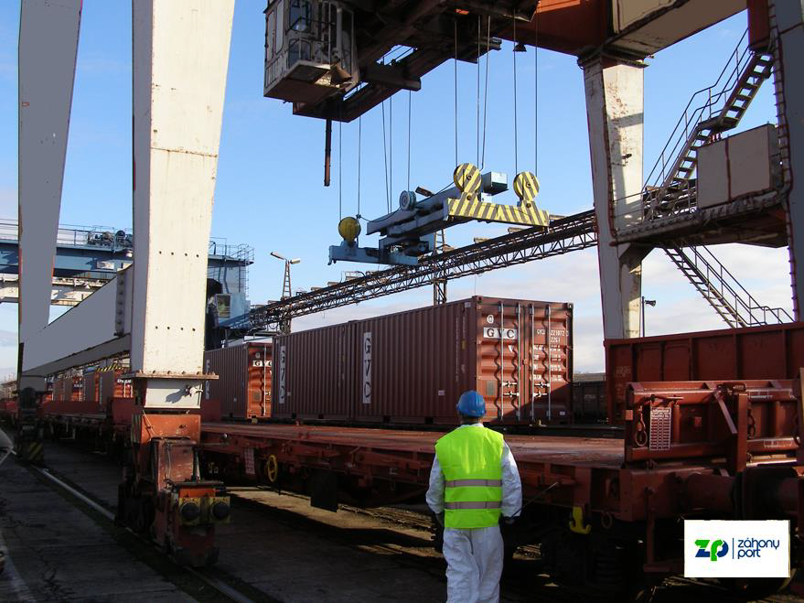
Loading by crane
4 cranetracks, 19 framecranes120 tonsgoodsinonepiecewithonelift
Capacity: 7000 tons/day,
Containerterminal:
Transshipment: 500 TEU/day
Buffering:1200 TEU

Slide 14
Záhony-Port Co.
Source: Záhony-Port Co.

Slide 15
Záhony-Port Co.
Source: Záhony-Port Co.

Slide 16
Rail Cargo Terminal-BILK Ltd.

Slide 17
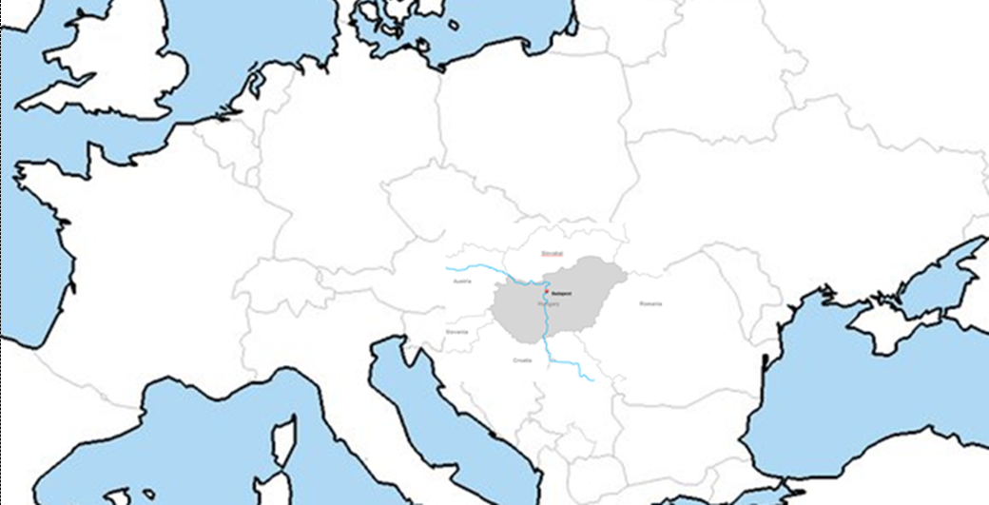
Rail network
BREMERHAVEN
HAMBURG
ROTTERDAM
Duisburg
NEUSS
LINZ
MÜNCHEN
WIEN
WELS
CHERTOMLIK
SALZBURG
TRIESTE
LJUBLJANA
Curtici
PLOJESTI
KOPER
CONSTANTA
RIJEKA
Surcin
Pireus
HALKALI

Slide 18
Introduction
Market leader combined terminal in the region
Excellent location
Situated in the heart of Central-Eastern Europe
Direct connection with M0 highway
Provides complex and high level services
Well equipped
2 sets of gantry cranes
5 reachstacker (4 loaded; 1 empty)
2 terminal tracktors
7 rail sidings (each 750 m long)
Annual capacity 250.000 TEU
Storage capacity: 7.500 TEU
Part of RFC6 and RFC7
Member of UIRR
ISO and AEO certification

Slide 19
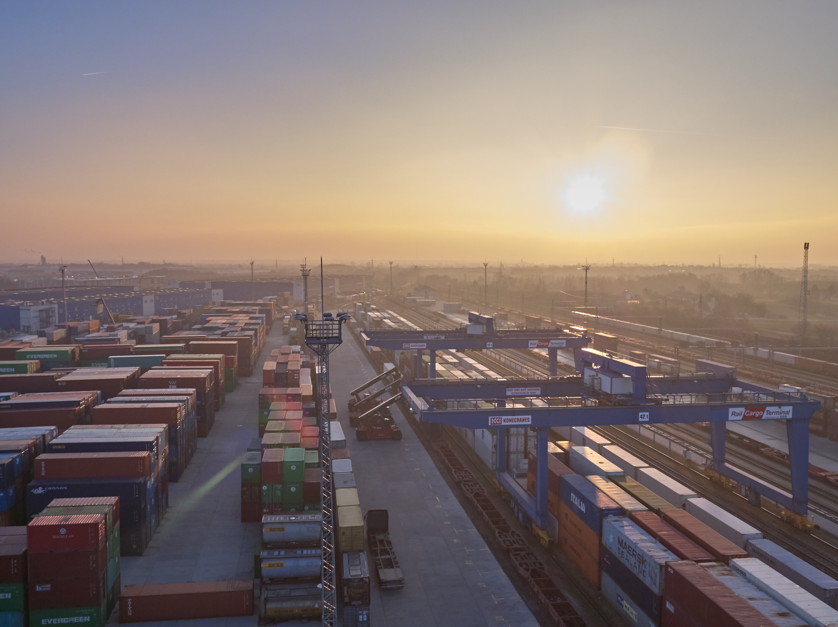
Provided services
Handling and storage of containers, semitrailers and swap bodies
Depot activity
Container repair works
Photographed seal control
VGM weighing service
Flexitank installation
ISO kit insulation
Transloading of cargo (eg.: coils)
Handling of reefer containers
ADR/RID

Slide 20
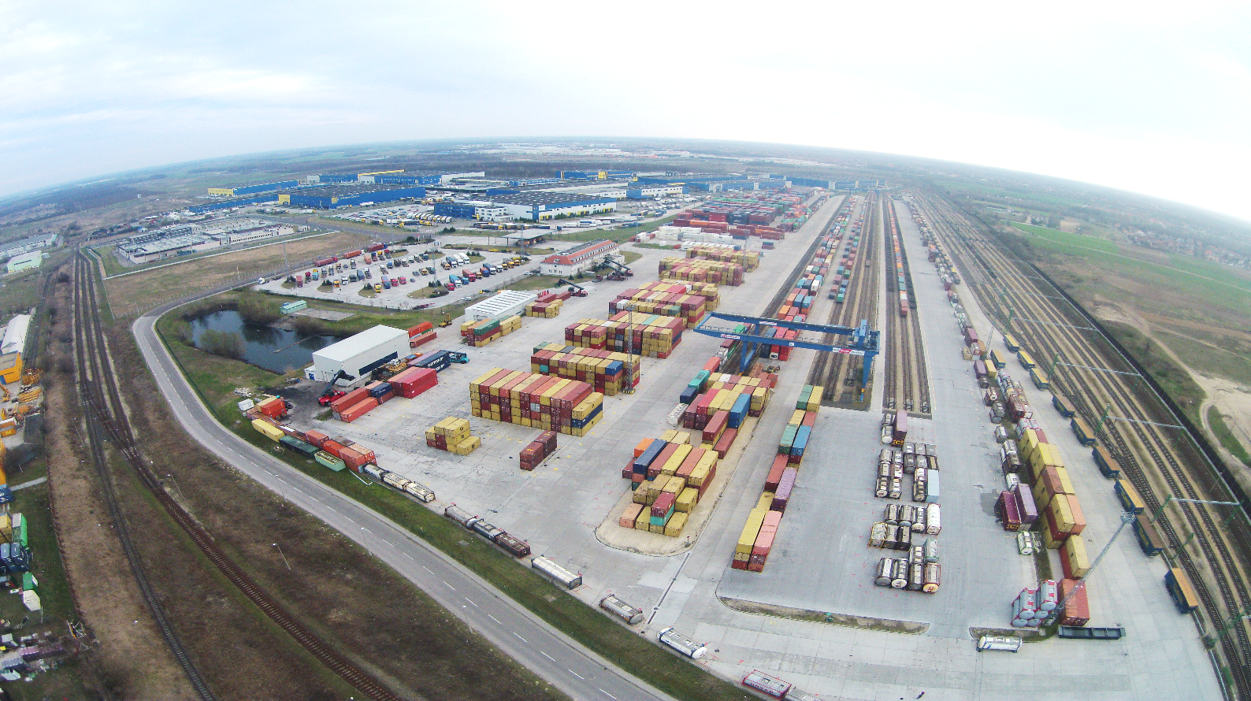
Rail Cargo Terminal-BILK Ltd.

Slide 21
THANK YOU FOR YOUR KIND ATTENTION
Daniel Dezso
daniel.dezso@railcargo.com
miklos.sebok@railcargo.com

