Slide 1

Slovak 's priorities on silky way through Ukraine
Odessa 1 June of 2017

Slide 2
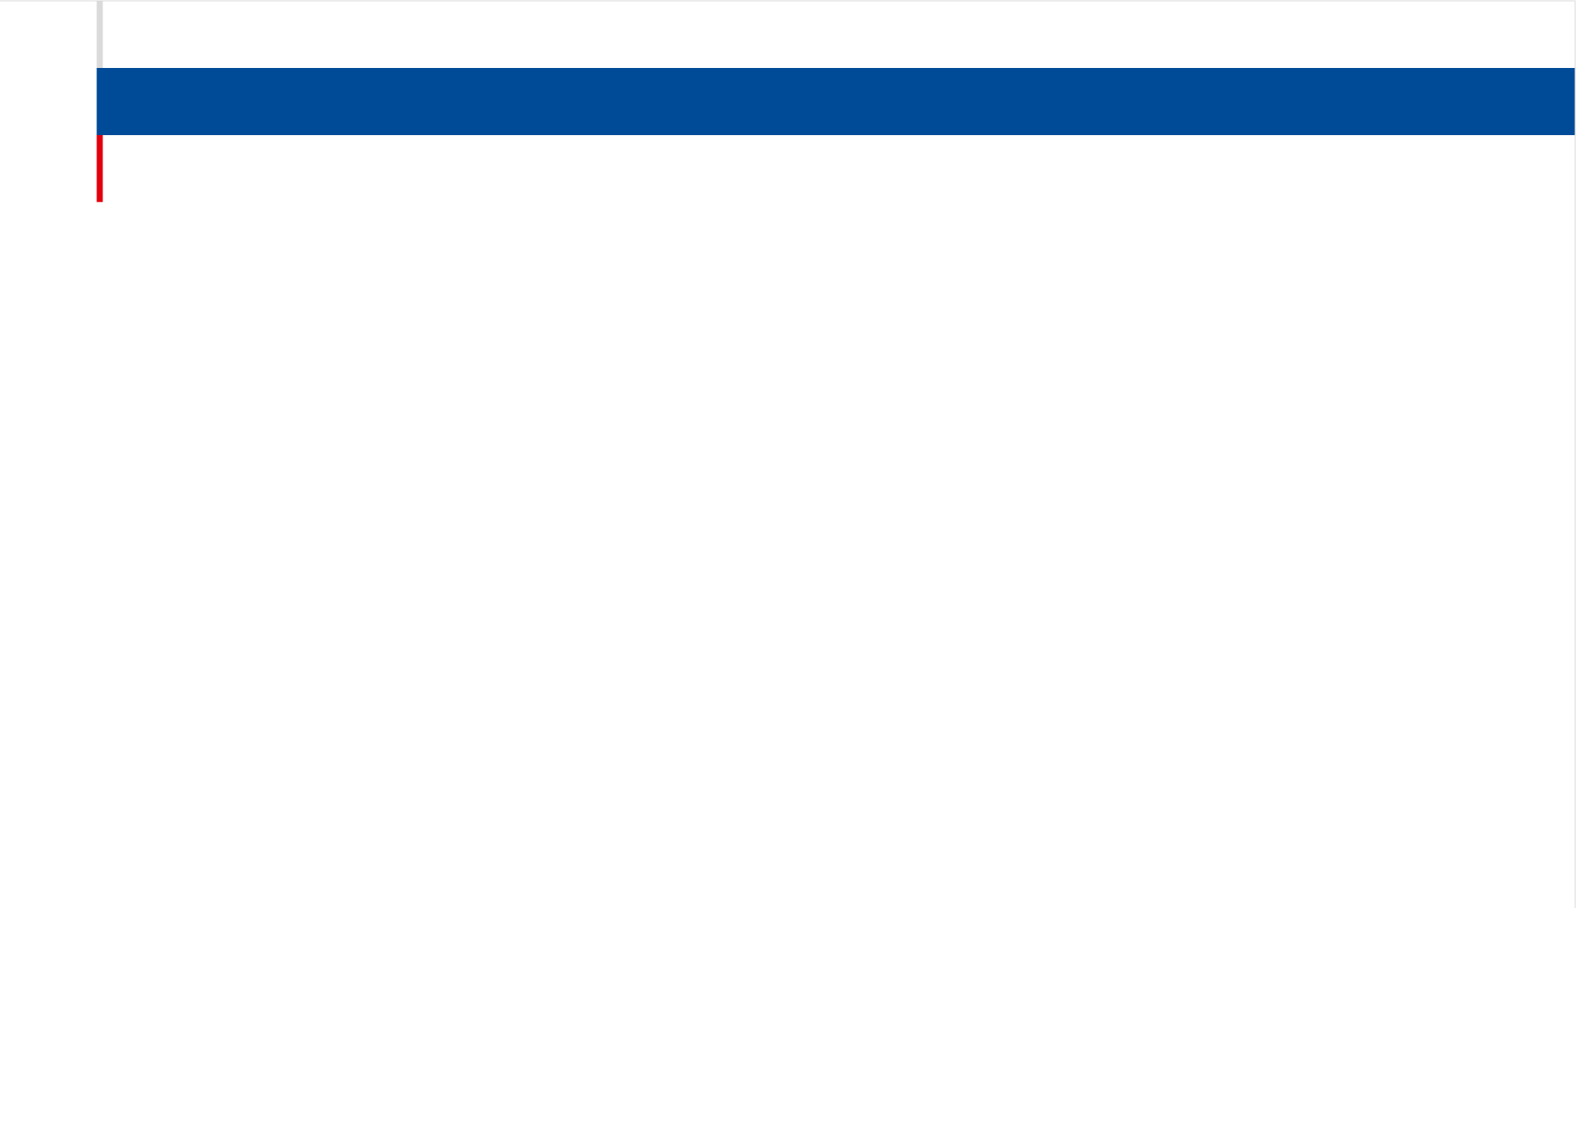
Combined transport Asia – Europe through Slovakia
Development of total performances of combined transport
Slovak 's priorities on silky way through Ukraine

Slide 3
Combined transport Asia – Europe through Slovakia
Short history in transported containers from 1. 9. 2009 till 31. 12. 2016
1 January of 2016 – Decree Nº 1 of the president Russian federation
6 April of 2016 – Decree No 276 of the Government Russian federation
1 July of 2016 – Decree No 319 of the president Russian federation
Year 2017 – absolute break of performances
Slovak 's priorities on silky way through Ukraine

Slide 4
Combined transport Asia – Europe through Slovakia
Slovakia – crossing of four main European corridors
Silk road
Slovak 's priorities on silky way through Ukraine

Slide 5
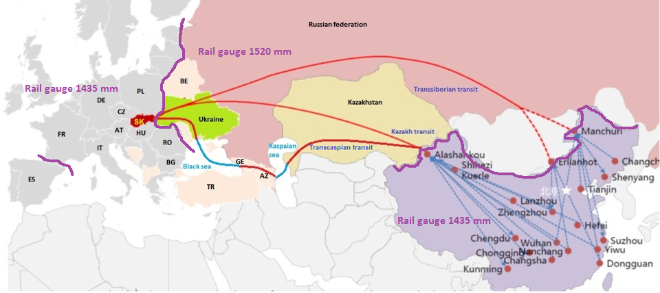
Combined transport Asia – Europe through Slovakia
Priority railway transport routes of Slovakia for silky way
Gateway into European union
Slovak 's priorities on silky way through Ukraine

Slide 6
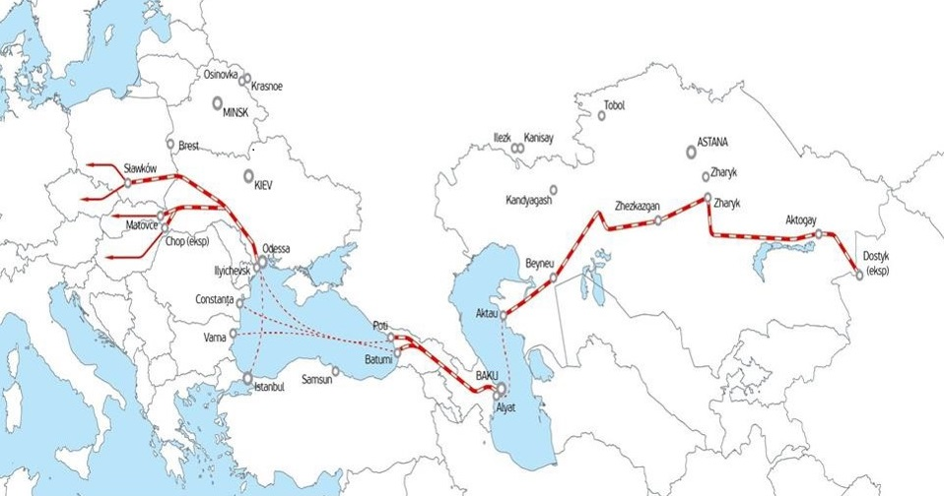
Combined transport Asia – Europe through Slovakia
Trans Caspian railways route for silky way
Slovak 's priorities on silky way through Ukraine

Slide 7
Combined transport Asia – Europe through Slovakia
Slovakia – transhipment points between 1435 mm and 1520 mm rail gauges tracks
planed
existing
Slovak 's priorities on silky way through Ukraine

Slide 8
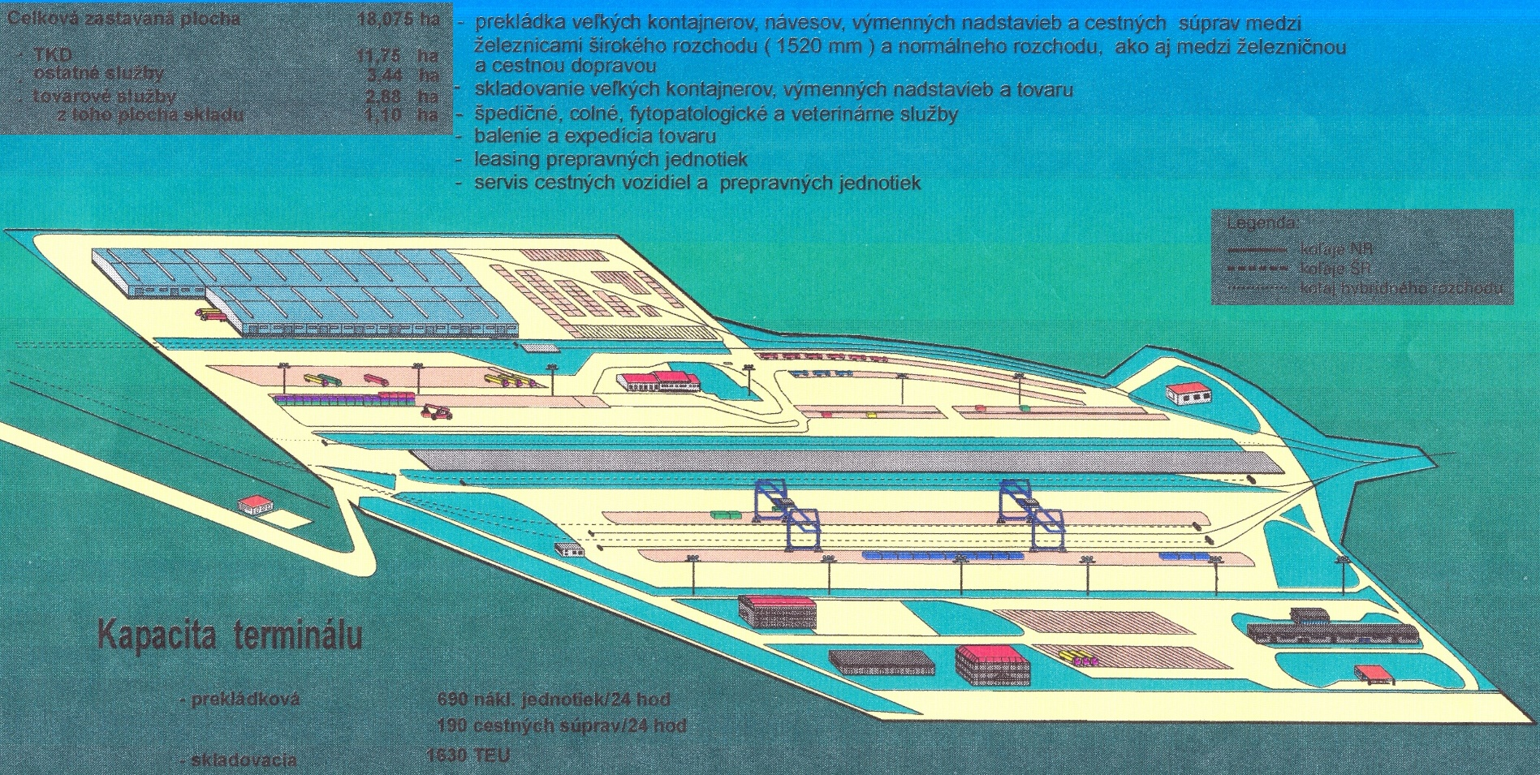
Combined transport Asia – Europe through Slovakia
Slovakia – intermodal terminal Dobrá by crossing border Čop/Čierna nd Tisou
Slovak 's priorities on silky way through Ukraine

Slide 9
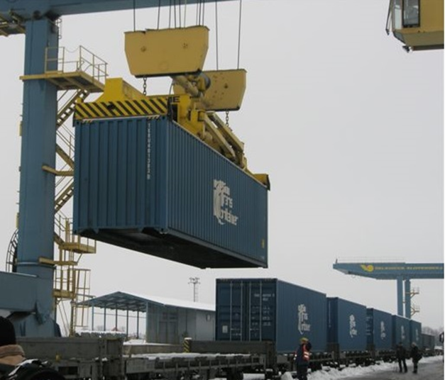
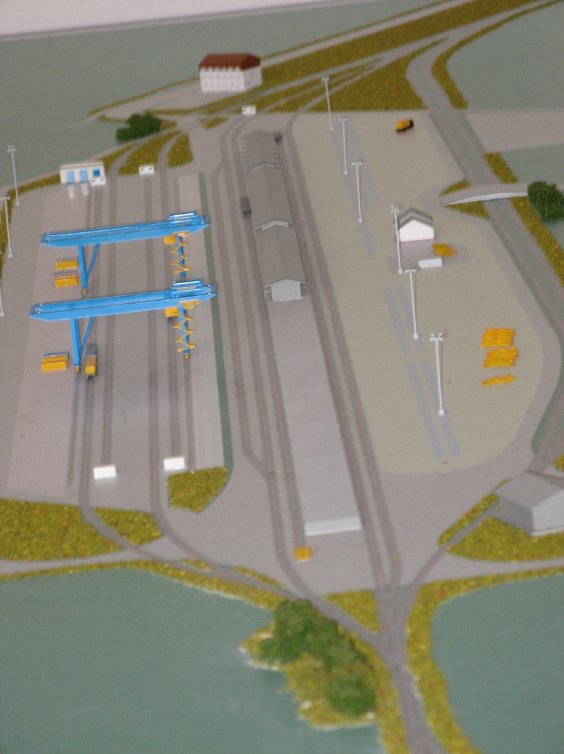
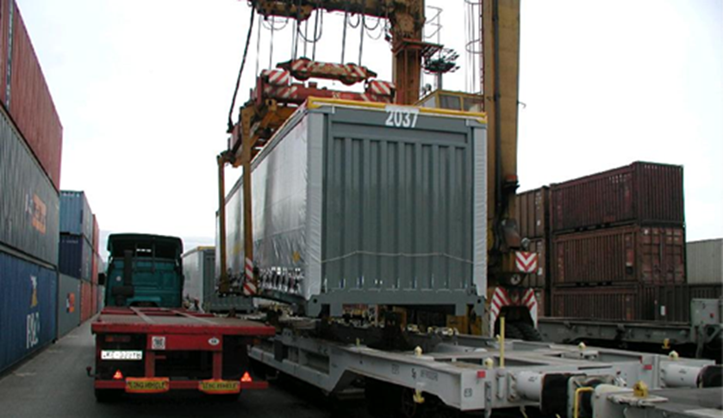
Combined transport Asia – Europe through Slovakia
Slovakia – intermodal terminal Dobrá by crossing border Čop/Čierna nd Tisou
Slovak 's priorities on silky way through Ukraine

Slide 10
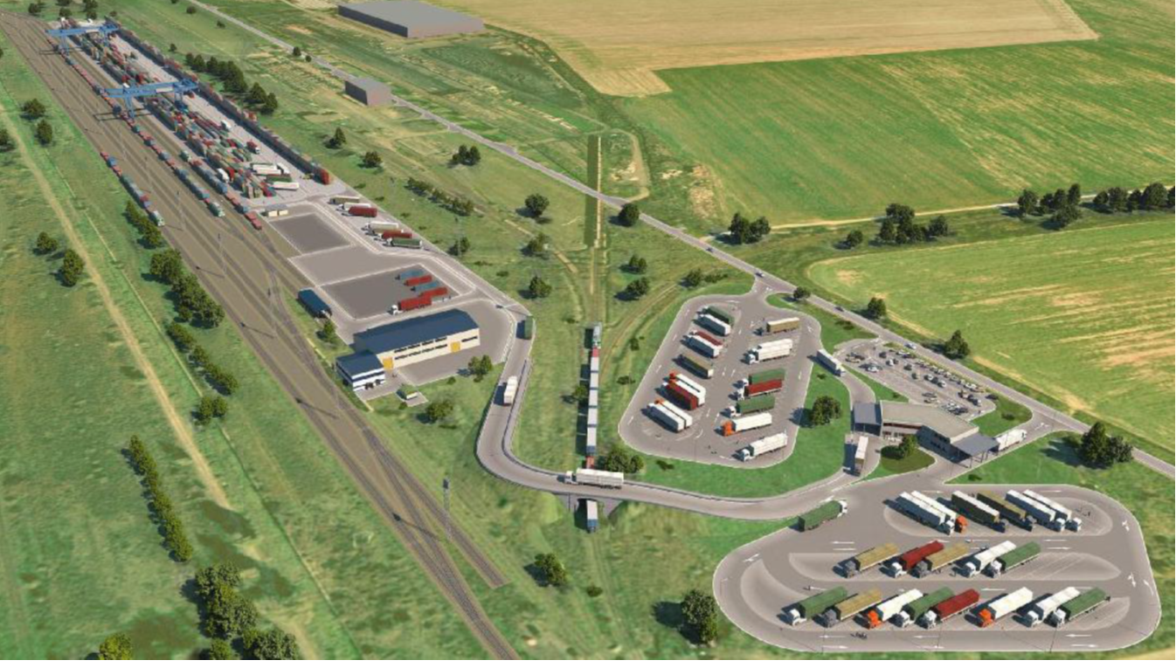
Combined transport Asia – Europe through Slovakia
Slovakia – planed intermodal terminal Košice - Bočiar
Slovak 's priorities on silky way through Ukraine

Slide 11
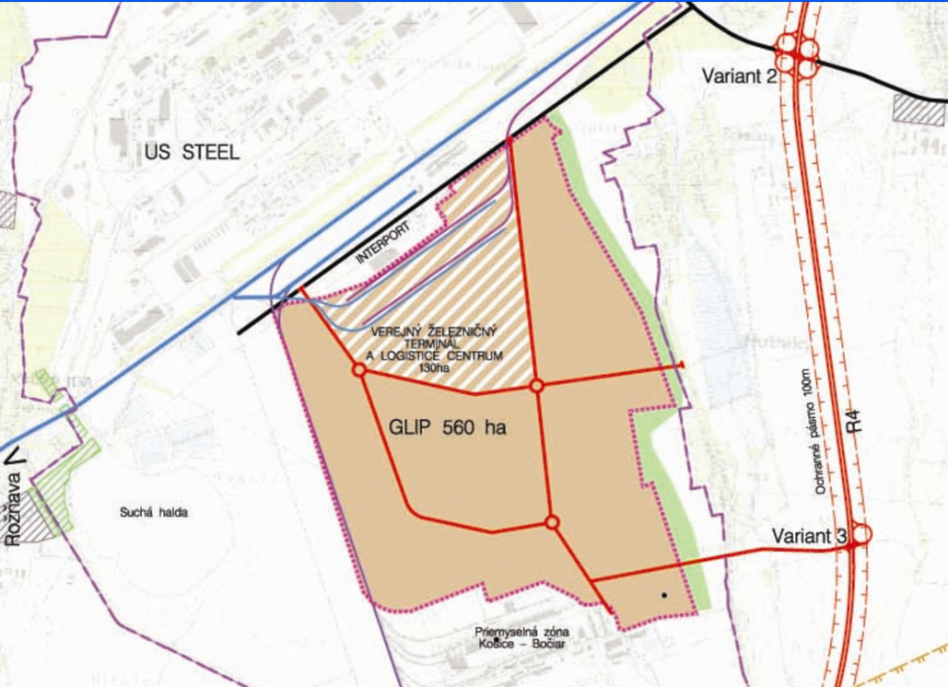



Combined transport Asia – Europe through Slovakia
Slovakia – intermodal terminal Košice and Global Logistics and Industrial park = logistics centrum
Logistics centrum
Intermodal terminal
1520 mm
Global Logistics and Industrial Park
1435 mm
Slovak 's priorities on silky way through Ukraine

Slide 12
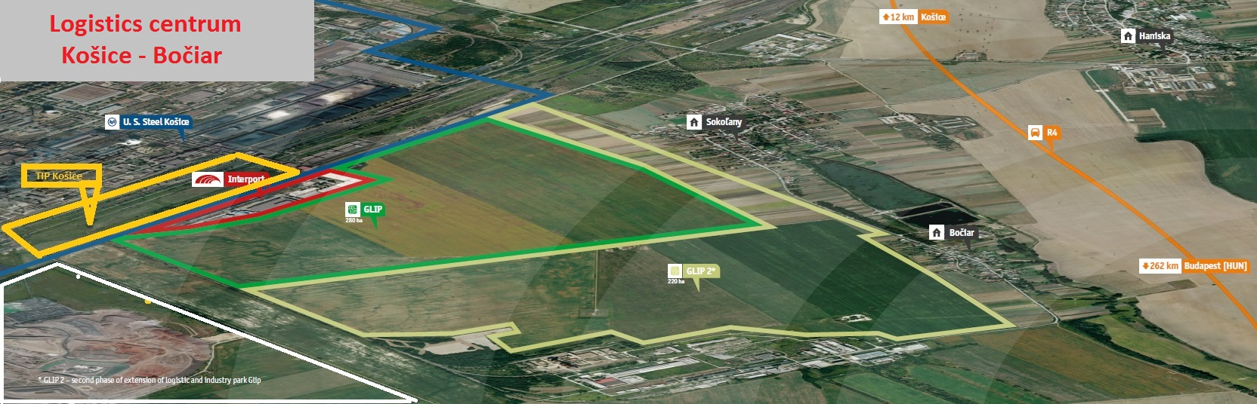
Combined transport Asia – Europe through Slovakia
Slovakia – logistics centrum Košice - Bočiar
Slovak 's priorities on silky way through Ukraine

Slide 13
Combined transport Asia – Europe through Slovakia
Thank you for attention !
Ing. Peter Hrapko – peter.hrapko@mindop.sk
Mgr. Pavol Marušinec – pavol.marusinec@mindop.sk
Slovak 's priorities on silky way through Ukraine

